Slide 1
Jordan: Sue, Kathy, Trish, Kerry & Tony

Slide 2
History: Kathy

Slide 3
References
Jordan | History, Population, Flag, Map, King, & Facts | Britannica
Jordan - 2021 World Factbook Archive (cia.gov)
The Country of Jordan - Facts and History (thoughtco.com)

Slide 4
1) Ancient Jordan
Early Kingdoms: Ammon, Moab, Edom
Assyrians, Babylonians, Persians, Seleucids, and the Roman Empire later controlled the area
2) 661 to 1517
Umayyad Empire (661 - 750 CE),
Abbasid Empire (750 - 1258)
The Mongols brought down the Abbasid Caliphate in 1258

Slide 5
3) 1517 to 1918
Under control of the Ottoman Empire
4) 1921 to 1946 British Protectorate
1921 Collapse of Ottoman Empire (After WW1)
In 1922, Britain assigned a Hashemite lord, Abdullah I, to govern Transjordan; his brother Faisal was appointed king of Syria, moved to Iraq.

Slide 6
5) 1949 to 1967
1946 – Jordan gained full independence and Abdullah I became King
1948 War
1950 King Abdullah I assassinated in Jerusalem
1953 King Hussein
1967 6 day war

Slide 7
6) 1990 to present day
1990 – 1991 Gulf War
1999 King Hussein dies
His son becomes King Abdullah II

Slide 8
GEOGRAPHY & PEOPLE : Tony

Slide 9
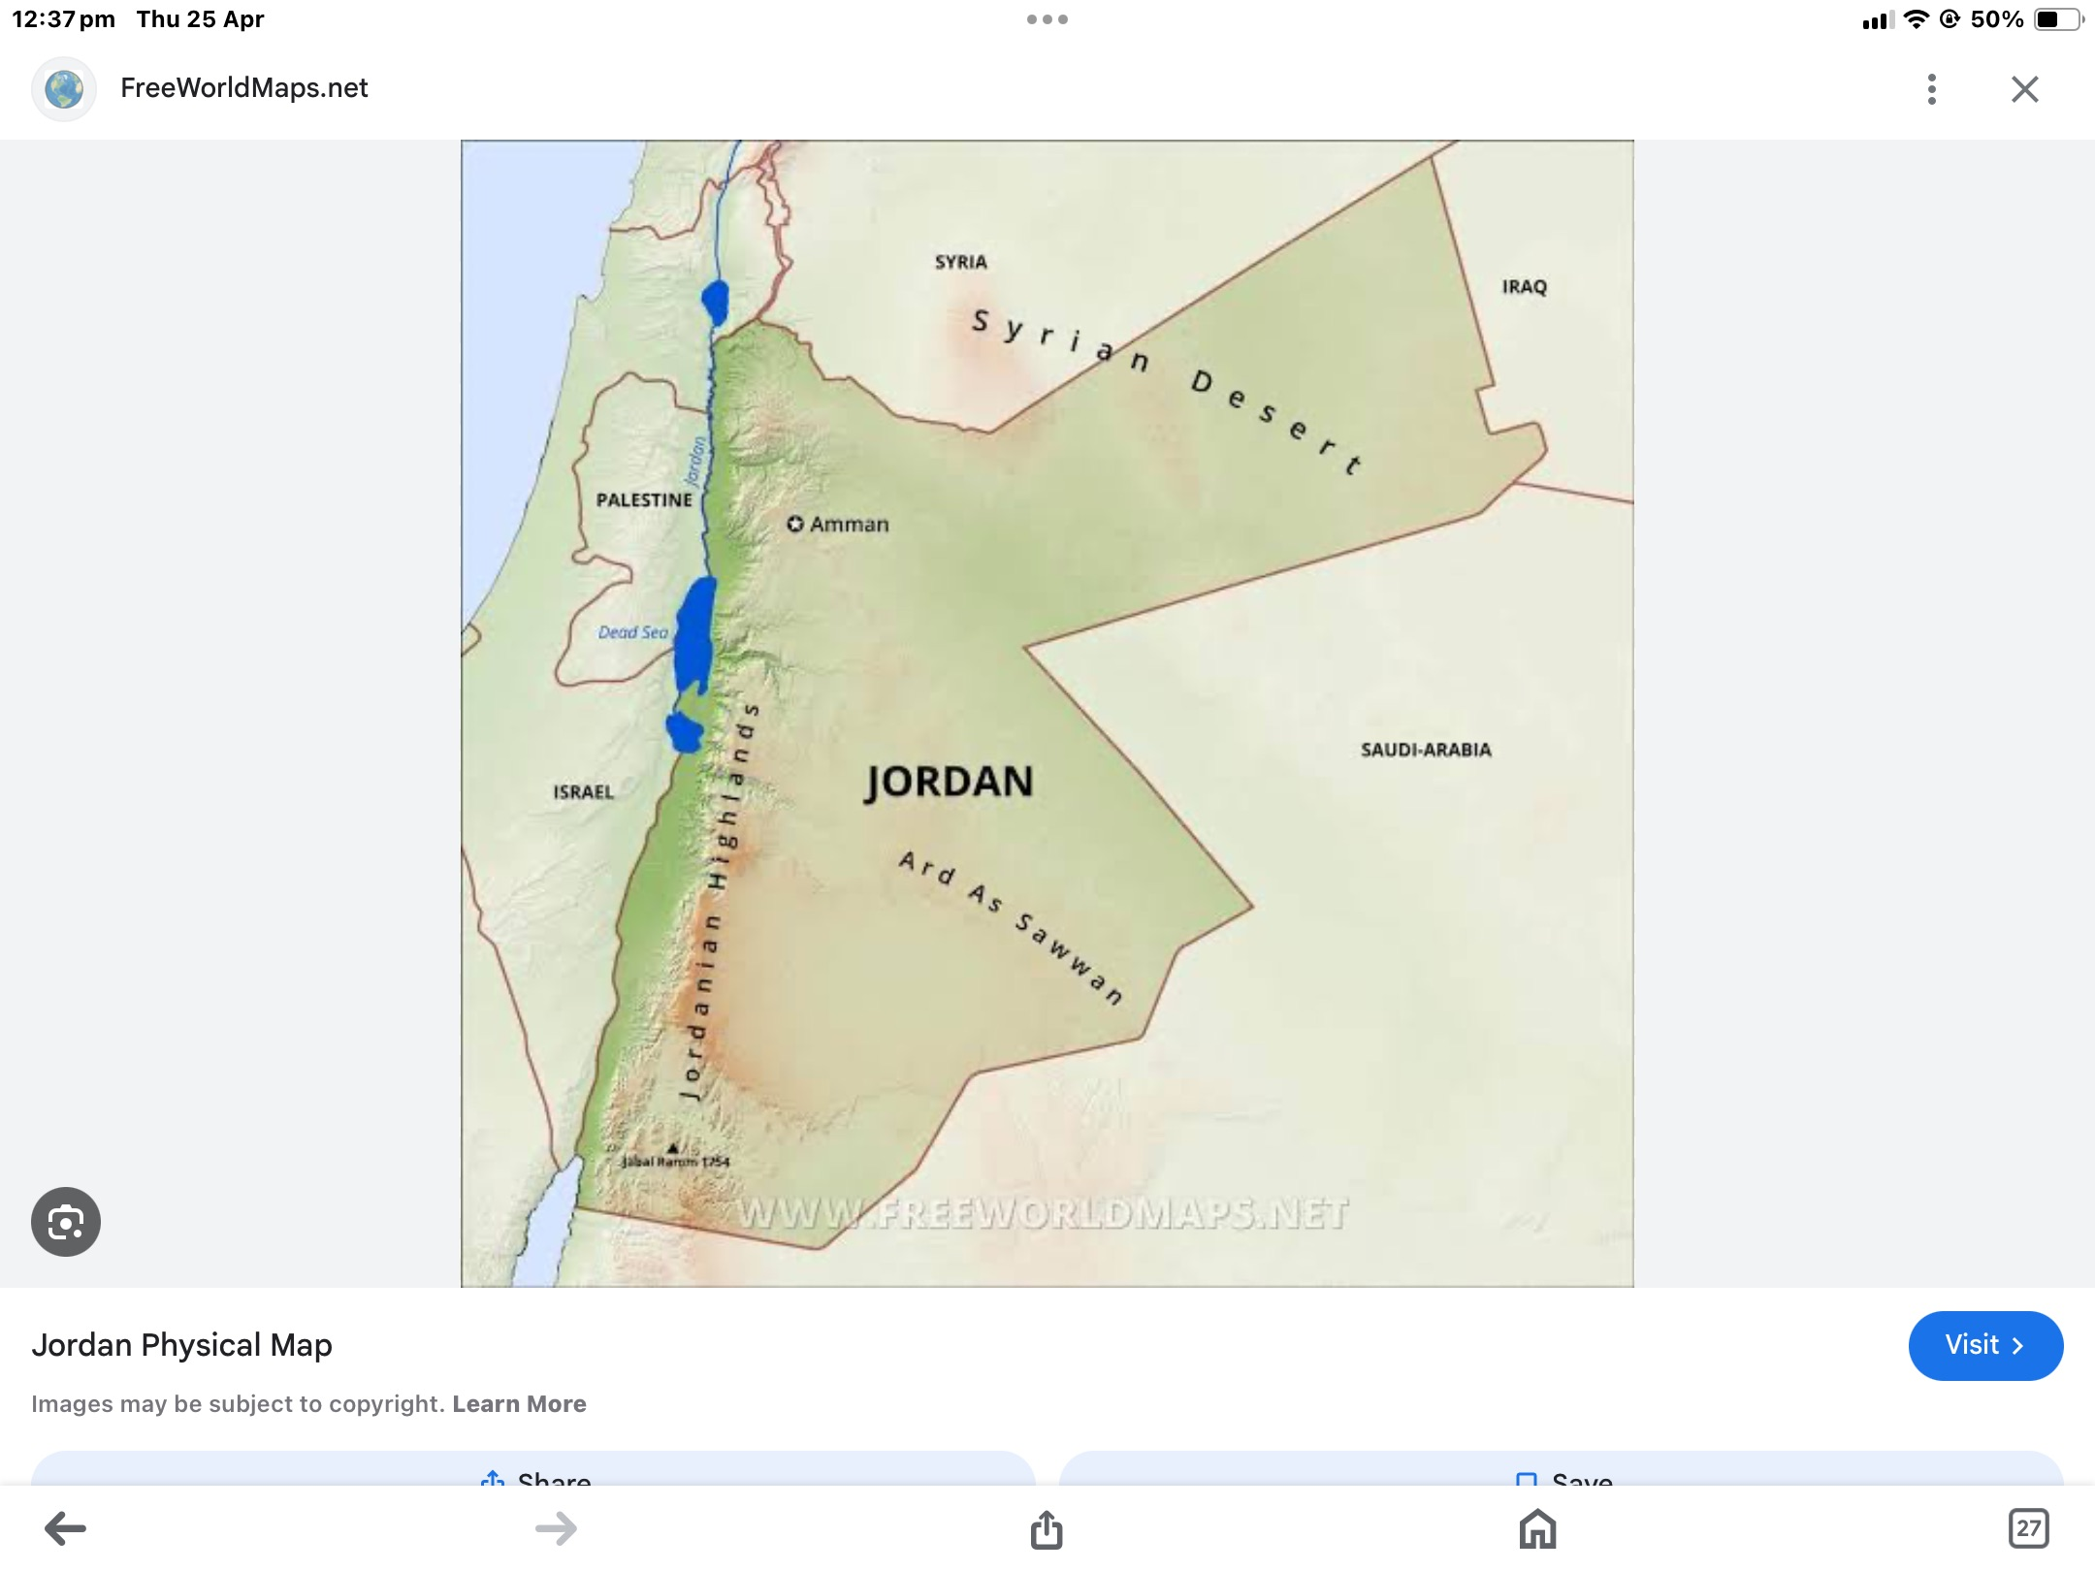

Slide 10
Geography
Surrounded by 5 States/Kingdoms
Land-locked, except for 16kms in Bay of Aqaba
Three main geographic/climatic areas:
1. The Jordon Valley
2. The Mountain Heights and Plateau
3. Eastern Desert

Slide 11
Jordan Valley
Most distinctive natural feature
Extends the entire Western flank of Jordan
Most fertile
Most populated

Slide 12
Mountain Heights and Plateau
North East region around Amman
Also South and West
Surprise – Jordon one of the most mountainous countries in the world, average 3,018 ft above sea level; but also has the lowest point on earth below sea level (dead Sea)

Slide 13
Eastern desert
The Badia region is a vast desert and forms part of The Sahara in the East
75% of Jordan is desert
Only 2.68% is arable land
1.1% forest
9.87 irrigated
11.98% agricultural

Slide 14
Population & People
Population:
Total 11,566,309 (April 2024)
Male/Female - 51.4% (m)/ 48.6% (f) (World Average 50.4/49.6)
Median Age 22.1 yrs (World 30.5 yrs)
Life expectancy 78.7 (m), 81.5 (f) (World 71.3)
Projected population increase this year : 350,000 (approx.)
Population doubled in past 20 years: note1948 & 1967

Slide 15
Who are these people?
Ethnicity – 94% Arabs
of which 2.3 million (+) are Palestinians refugees
- Indigenous groups: Bedouins of Jordan origin, nomadic tribes (Ammonites, Moabites, Edomites, Israelites)
Ethnic minorities :
Circassians (3%), Chechens (2%)
Armenians & Kurds (1%)

Slide 16
Government & Languages: Sue

Slide 17
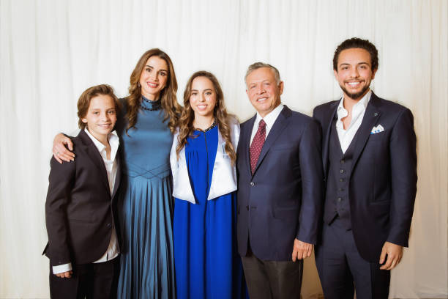
C0NSTITUTIONAL MONARCHY

Slide 19
THREE BRANCHES OF GOVERNMENT
1. Executive Branch
Monarch
Prime Minister

Slide 20
2. Legislative Branch:
- Bicameral Parliament: two houses:
- The Chamber of Deputies: elected representatives who serve four-year terms.
- The Senate: Appointed by the King,

Slide 21
3. Judicial Branch:
- Judiciary: independent and based on Islamic law (Sharia) for personal status matters.
- includes regular civil and criminal courts, as well as a specialized court system for issues like military and security cases.

Slide 22
Local Government in Jordan:
- divided into twelve governorates, each headed by a governor appointed by the central government : (qadas),(nahias), and municipalities.
Municipalities have varying degrees of autonomy,
- Municipalities are responsible for local services
Overall, Jordan's government structure blends traditional monarchy with elements of modern democratic governance, aiming to balance stability with responsiveness to the needs of its citizens.15 seats for women, 9 seats for Christians, 3 for Chechens and Circassians

Slide 23
Voting in Jordan
- structured to ensure representation in the country's legislative body, the Chamber of Deputies, which is part of the Parliament.
1. **General Elections**:
- to elect members of the Chamber of Deputies.
- based on a mixed-member proportional representation
- Seats in the Chamber of Deputies are allocated proportionally to political parties or coalitions
- The electoral law in Jordan stipulates a quota for women's representation in the Chamber of Deputies,

Slide 24
2. Voter Eligibility:
- citizens who are at least 18 years old
- specific criteria for candidates running for office
3. Local Elections:
- to elect members of municipal councils and mayors
- The electoral process for local elections may vary depending on the specific municipality
--------------------------------------------------------------------------------------------------------------------
Overall, the voting system in Jordan aims to provide representation for various political parties and ensure a fair allocation of seats in the Chamber of Deputies. Additionally, efforts have been made to promote inclusivity through measures such as quotas for women's representation in Parliament.

Slide 25
Languages: Official = Arabic
1. Jordanian Arabic
2. English
3. Bedouin Arabic
4. Armenian
5. Circassian
6. Chechen
These are some of the main languages spoken in Jordan, reflecting the country's diverse cultural and ethnic makeup.

Slide 26
Economy & Challenges : Kerry

Slide 27
Jordan Economy
Jordan’s economy is classified as an ‘emerging market economy’
Central Bank of Jordan established in 1964
The Central Bank is the sole issuer of the Jordanian dinar
IMF has pegged the Jordanian dinar to approx. US$0.710
World Bank classifies Jordan as a ‘lower middle-class country’
Free trade agreements with the US and other countries
Notes:
An emerging market economy is transitioning from a low-income, less developed, often pre-industrial economy that is focused on agriculture and resource extraction towards a modern, industrial economy with manufacturing, a higher standard of living, accessibility by foreign investors, and a dependable regulatory system with modern financial institutions and infrastructure, for example, the completion of the renovation and expansion of Jordan’s international airport by 2013 was a colossal public-private undertaking. Different organisations, for example, the International Monetary Fund may have different classification criteria. (Ref: Investopedia)

Slide 28
Jordan Economy
Service industries account for 70% economy
Industry & agriculture have 30%
Agriculture: 40% of Gross National Income in 1950s to 6% in 1980s
Jordan is one of the poorest countries in terms of water per capita
Jordan Valley produces fruit, vegetables, cereal
Small fishing and forestry industry
3rd largest producer of World’s raw phosphates
Exports also include fertilisers, clothing & pharmaceuticals

Slide 29
Jordan Economy
Seeks to become a regional centre of excellence in 3 key areas:
Education, IT & health services
Aims to improve and modernise transportation of goods and people
Capital Amman is in the top 10 world cities for tech start-up launches
Hosted World Economic Forum on Middle East and Nth Africa 6 times
Hosts prestigious Mercedes Benz Fashion Week semi-annually

Slide 30
Jordan Challenges
Relies on importing oil & only has a modest natural gas reserve)
Vulnerable to regional and global issues
Domestic pressures are growing within Jordan due to rising tension and conflict in the Middle East region
Jordan has one of the highest intakes of refugees per capita in the world: Palestinians, Syrians & Iraqis
The COVID-19 pandemic has also taken its toll on Jordan's economy, particularly the tourist sector (previously accounted for 19.4% of GDP)
Notes:
An emerging market economy is transitioning from a low-income, less developed, often pre-industrial economy to a modern, industrial economy with a higher standard of living.

Slide 31
Jordan Challenges
25% unemployment in 2021
45% unemployment among youth
Lead to later marriage age and increased mental health problems
30% unemployment among women
One of the World’s lowest female employment participation rates (14%)
30% unemployment among those with a university degree
Mean wage $4.10 per hour for average worker in 2009

Slide 32
References: Economy & Challenges
The World Bank
Jordan’s Minister of Finance at the Wilson Center
Foreign Policy Research Institute
Department of Foreign Affairs, Australia
Wikipedia

Slide 33
Culture, Religion, Relationship with Australia: Trish

Slide 34
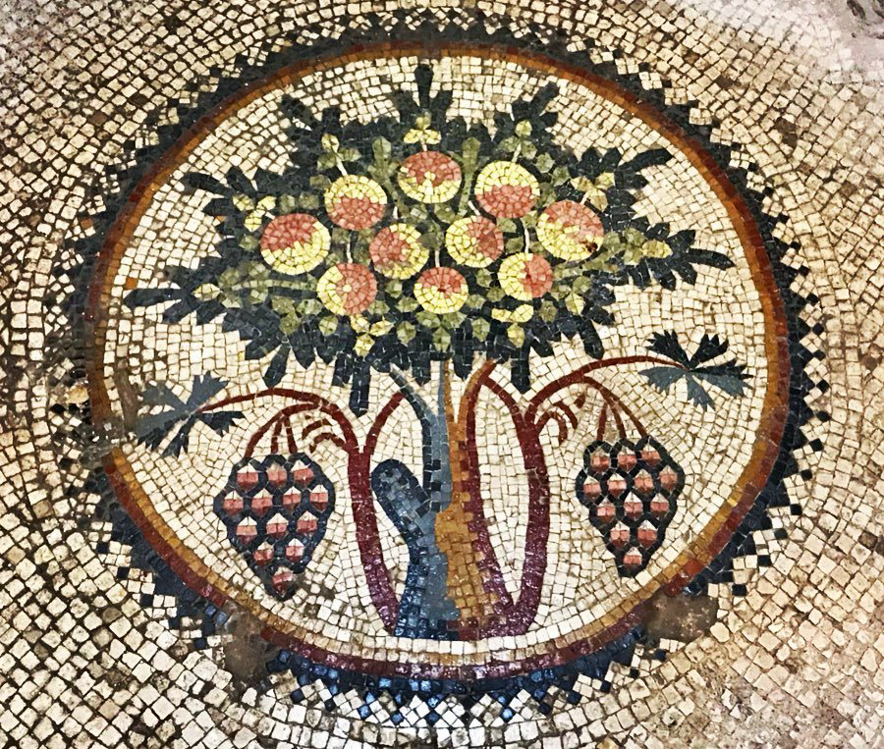
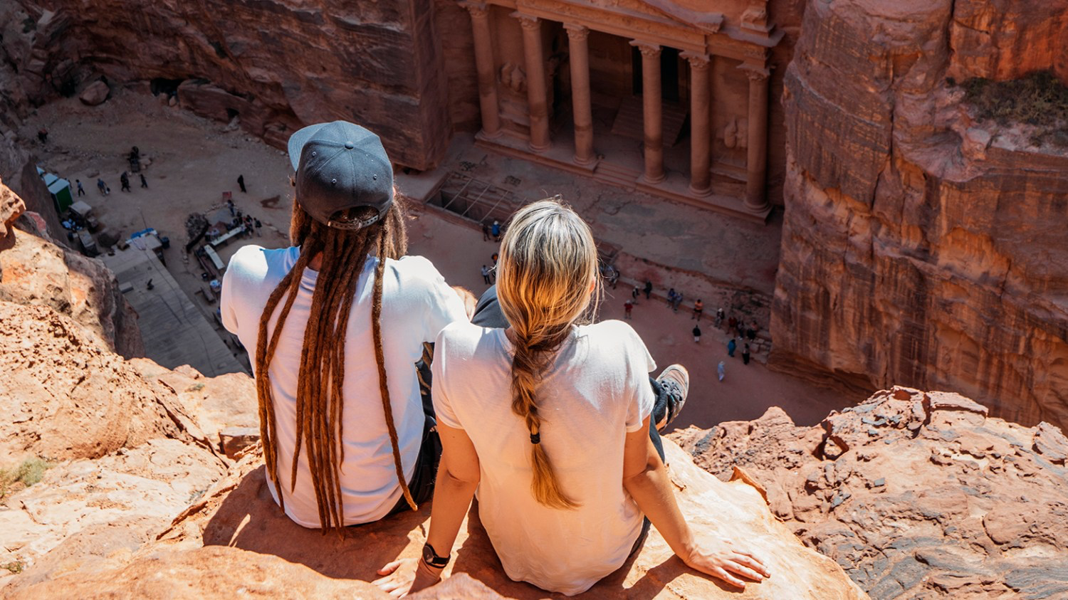
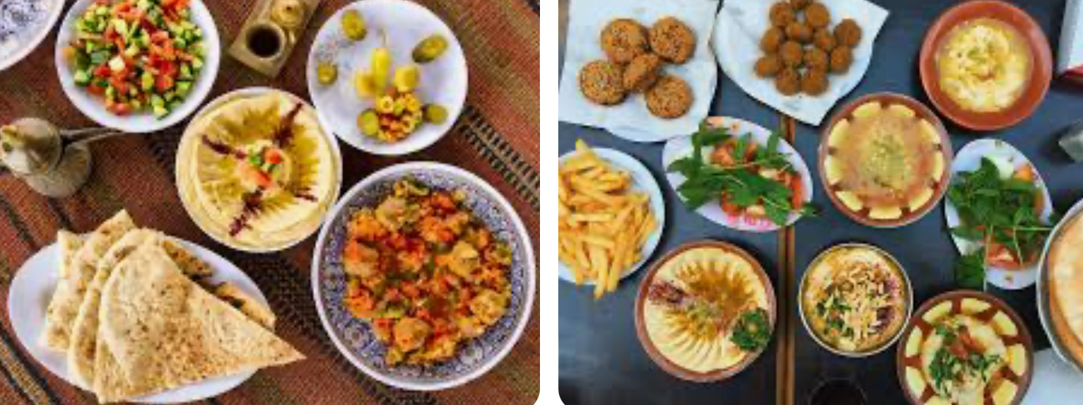
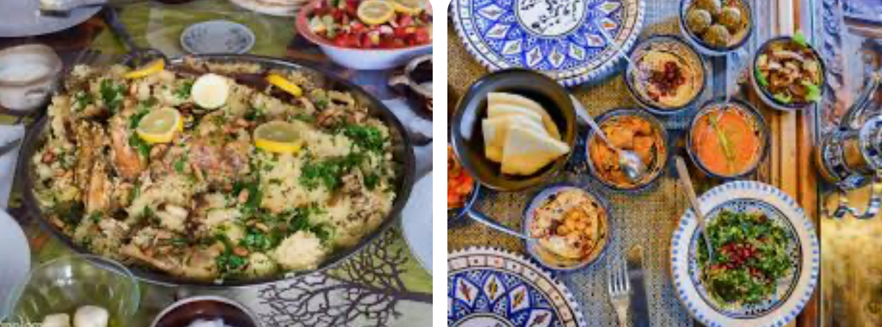
On 20 May 2024, at 11:33 am, Trish Davie <trishdavie19@gmail.com> wrote:
﻿LANGUAGE All Jordanians speak Arabic, the official language of the kingdom, regardless of race or religion.
CURRENCY The official currency of the country is the Jordanian Dinar
WORKING HOURS
Government departments, offices and banks shut down on Fridays and Saturdays every week. Open from 8 am to 3 pm
HOMES and ARCHITECTURE
Majority are one or two room apartments or houses
Affluentfamilies more spacious and separate individual homes , mostly mud-brick some of modern stone.
Nomadic farmers live in tents Street identification, numbers and maps are inefficient and hard to use.
LAND TENURE Land ownership is the goal but few can afford the cost except for the very wealthy. So most live in rented housing.
BASIC ECONOMY
Free enterprise. The service sector - government, tourism, transportation, communication, & financial services, contribute most to the economy & over 70% of the workforce.
MAJOR PRODUCTION Refined petroleum products, manufacturing of cement and fertilisers, potash, phosphate and gypsum mining
TRADE Amongst the world’s top three potash exporters.
Since Gulf War the number of immigrants has increased.
Now has severe trade deficit and not enough jobs.
Location in Middle East impacts Jordanian economy & dependence on foreign aid Tourism offers greatest prospect for development
CLASS & CASTES
Class centred around extended patriarchal family units based on ancestry and wealth. Led by sheikhs elder son who ascends to the position of head of the family.
SYMBOLS OF SOCIAL STRATIFICATION
Modern Arab culture values college education, Mercedes cars and a home in an urban area as symbols of success,
In rural culture camel breeders highest on the social scale.
Traditionally don't marry outside a persons clan, all others considered inferior.
LAWS ARE BASED ON THE QURAN & THE HADIT
( collection of Mohaddan sayings) enforced in(religious) Sharia courts. EG Virginity demanded of all single women on pain of possible death by male family member.
Jordan has a low crime rate by international standards
MILITARY POWER
Jordan maintains an army, air force and a small navy with active members and reserves. There is a large paramilitary force including civil militia members and public security offices. Jordon is regarded as one of the most peaceful & peace making countries in the Middle East,
SOCIAL & FAMILY HEALTH No comprehensive welfare system, & government administers medical and health services.
GOVERNMENTAL ORGANISATIONS. Involved with the environment, women, children and economic issues. The royal family is supportive of many charitable foundations, including an annual summer Festival of culture and arts. Jordanian fund for human development has social development centres throughout the country and helps women and children
GENDER & STATUSES Division of labour by gender mostly controlled by male relatives, (slowly changing with advances in education for women just 3 to 4 decades ago .
Unemployment rate for women remains high
STATUS OF WOMEN & MEN Sons are prized, most Muslim women cover their heads with scarves. A small percentage cover their faces. Segregation of the sexes in all public situations, limited interaction between men and women, they eat apart in restaurants.
MARRIAGE, FAMILY & KINSHIP Getting married and having children are top priorities often / usually arranged by the father of the bride.
Often cousins may marry each other the couple may barely know each other prior to engagement.
After marriage every aspect of a woman’s life dictated by her husband passport or travel cannot happen without approval. Husband may take up to 4 wives. Divorce is legal. Children automatically go to the father so women usually choose to remain in a marriage even with other wives.
CHILDCARE
Usually women are primary caregivers.
After first son is born father and mother take the name of the son as part of theirs
EDUCATION Primary education is free and compulsory from 6 to 16yrs For Palestine refugees UNRWA provide schooling for them Higher education - prerequisite for university entrance is an extensive examination prior to graduation from secondary school
ETIQUETTE Lengthy and sincere greetings, sharing gifts, kindness, modest dress, no alcohol, removal of shoes before entering mosque and home, rigid rules on touching same and opposite sex. Many more, part of tradition.
SHARING FOOD BRINGS PEOPLE TOGETHERbrings Traditional dishes Lamb rice hummus, yoghurts, nuts and herbs etc etc. And don’t forget the olives. Jordan is most the top olive producing countries in the world
few Protestant denominations.
Religions
Muslim 97.1% (official; predominantly Sunni), Christian 2.1% (majority Greek Orthodox, but some Greek and Roman Catholics, Syrian Orthodox, Coptic Orthodox, Armenian Orthodox, and Protestant denominations), Buddhist 0.4%, Hindu 0.1%, Jewish <0.1%, folk <0.1%, other <0.1%, unaffiliated <0.1% (2020 est.)
us

Slide 36
LANGUAGE All Jordanians speak Arabic, the official language of the kingdom, regardless of race or religion.
CURRENCY The official currency of the country is the Jordanian Dinar
WORKING HOURS
Government departments, offices and banks shut down on Fridays and Saturdays every week. Open from 8 am to 3 pm
HOMES and ARCHITECTURE
Majority are one or two room apartments or houses
Affluent families more spacious and separate individual homes , mostly mud-brick some of modern stone.
Nomadic farmers live in tents Street identification, numbers and maps are inefficient and hard to use.
﻿

Slide 37
LAND TENURE Land ownership is the goal but few can afford the cost except for the very wealthy. So most live in rented housing.
BASIC ECONOMY
Free enterprise. The service sector - government, tourism, transportation, communication, & financial services, contribute most to the economy & over 70% of the workforce.
MAJOR PRODUCTION Refined petroleum products, manufacturing of cement and fertilisers, potash, phosphate and gypsum mining
TRADE Amongst the world’s top three potash exporters.
Since Gulf War the number of immigrants has increased.
Now has severe trade deficit and not enough jobs.
Location in Middle East impacts Jordanian economy & dependence on foreign aid Tourism offers greatest prospect for development

Slide 38
CLASS & CASTES
Class centred around extended patriarchal family units based on ancestry and wealth. Led by sheikhs elder son who ascends to the position of head of the family.
SYMBOLS OF SOCIAL STRATIFICATION
Modern Arab culture values college education, Mercedes cars and a home in an urban area as symbols of success,
In rural culture camel breeders highest on the social scale.
Traditionally don't marry outside a persons clan, all others considered inferior.
LAWS ARE BASED ON THE QURAN & THE HADIT
( collection of Mohaddan sayings) enforced in(religious) Sharia courts. EG Virginity demanded of all single women on pain of possible death by male family member.
Jordan has a low crime rate by international standards

Slide 39
GENDER & STATUSES Division of labour by gender mostly controlled by male relatives, (slowly changing with advances in education for women just 3 to 4 decades ago .
Unemployment rate for women remains high
STATUS OF WOMEN & MEN Sons are prized, most Muslim women cover their heads with scarves. A small percentage cover their faces. Segregation of the sexes in all public situations, limited interaction between men and women, they eat apart in restaurants.
MARRIAGE, FAMILY & KINSHIP Getting married and having children are top priorities often / usually arranged by the father of the bride.
Often cousins may marry each other the couple may barely know each other prior to engagement.
After marriage every aspect of a woman’s life dictated by her husband passport or travel cannot happen without approval. Husband may take up to 4 wives. Divorce is legal. Children automatically go to the father so women usually choose to remain in a marriage even with other wives.

Slide 40
CHILDCARE
Usually women are primary caregivers.
After first son is born father and mother take the name of the son as part of theirs
EDUCATION Primary education is free and compulsory from 6 to 16yrs For Palestine refugees UNRWA provide schooling for them Higher education - prerequisite for university entrance is an extensive examination prior to graduation from secondary school
ETIQUETTE Lengthy and sincere greetings, sharing gifts, kindness, modest dress, no alcohol, removal of shoes before entering mosque and home, rigid rules on touching same and opposite sex. Many more, part of tradition.

Slide 41
SHARING FOOD BRINGS PEOPLE TOGETHERbrings Traditional dishes Lamb rice hummus, yoghurts, nuts and herbs etc etc. And don’t forget the olives. Jordan is most the top olive producing countries in the world

Slide 42
Religions
Muslim 97.1% (official; predominantly Sunni),
Christian 2.1% (majority Greek Orthodox,
but some Greek and Roman Catholics,
Syrian Orthodox,
Coptic Orthodox
Armenian Orthodox,
and Protestant denominations),
Buddhist 0.4%, Hindu 0.1%,
Jewish <0.1%, folk <0.1%, other <0.1%, unaffiliated <0.1% (2020 est.)

Slide 43
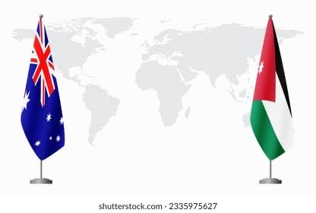
AUSTRALIA'S RELATIONSHIP WITH JORDAN

Slide 44
AUSTRALIA'S RELATIONSHIP WITH JORDAN
Warm and increasingly diverse relationship
Jordanian embassy in Canberra since 1976
Australian embassy in Amman since 1979
Links extend back over century, Australian military forces deployed in Middle East during World War I
In early 1918, crossed the Jordon River from Jerusalem to support the ‘Great Arab Revolt’ against Ottoman rule.

Slide 45
BILATERAL RELATIONS
Diplomatic ties
Long-standing defence and security cooperation
Close people to people links
Growing trade and commercial engagement
Members of the Daesh, participates in the Jordan-Aqua Project
Strong history of technical cooperation on water, climate, and the environment.

Slide 46
HUMANITARIAN ASSISTANCE
Approx $525 million since 2011, (including over $136 million in support of refugees and their host communities in Jordan)
Supports host communities in need, with a focus on women’s economic empowerment and inclusion.
The Australian Embassy in Amman’s Direct Aid Program also supports key areas including gender equality, disability inclusion and youth empowerment.

Slide 47
TRADE & INVESTMENT
Bilateral commercial relations in green energy, agricultural technology, mining and mining services, and food.
Principle exports to Jordan are meat products, other agricultural commodities, and education services.
In 2020-21, two‑way goods and services trade was $138 million ($85 million in exports to Jordan and $53 million in imports from Jordan).
Australia’s major exports to Jordan include non-beef meat ($31 million), beef ($7 million), and vegetables ($6 million).
In 2005 Australia concluded an MOU with Jordan on live animal shipment to ensure respect of international animal welfare standards.
Live exports also covered by the Exporter Supply Chain Assurance System (ESCAS).
Austrade's office in Riyadh is responsible for Jordanian trading with market profiles of priority sectors, such as education, food, health, and medical.

Slide 48
HIGH LEVEL VISITS.
Strong relationship supported by regular high-level contact, ministerial level visits, and Parliamentary delegations apart from during Covid
Visit by King Abdullah and Queen Rania in 2016
A number of high level visits by Australians to Jordan, since 2015 including Sir Peter Cosgrove (Gov Gen) and most ministries for defence & immigration.
The latest Census in 2016 recorded 5,912 Jordan-born people in Australia, an increase of 28.0 per cent from the 2011 Census. Jordanians are a relatively new migrant group to Australia.

Slide 49
