Slide 1
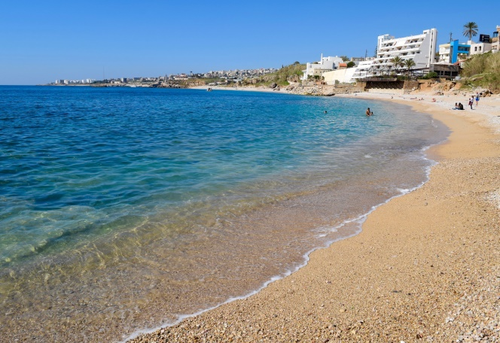
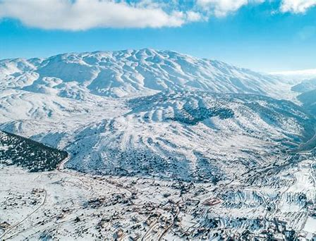
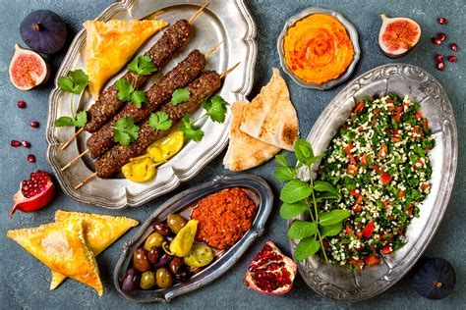
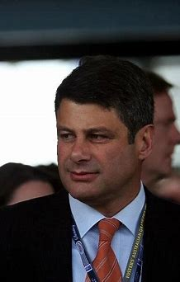
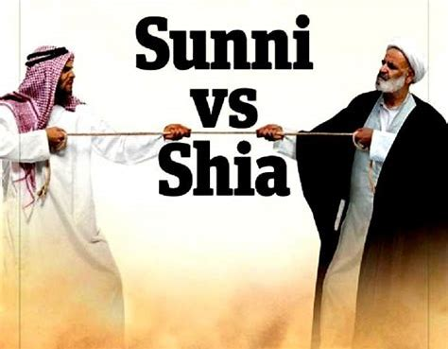
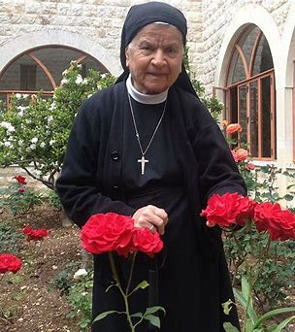

Slide 2
LEBANON
A
FAILED STATE

Slide 3
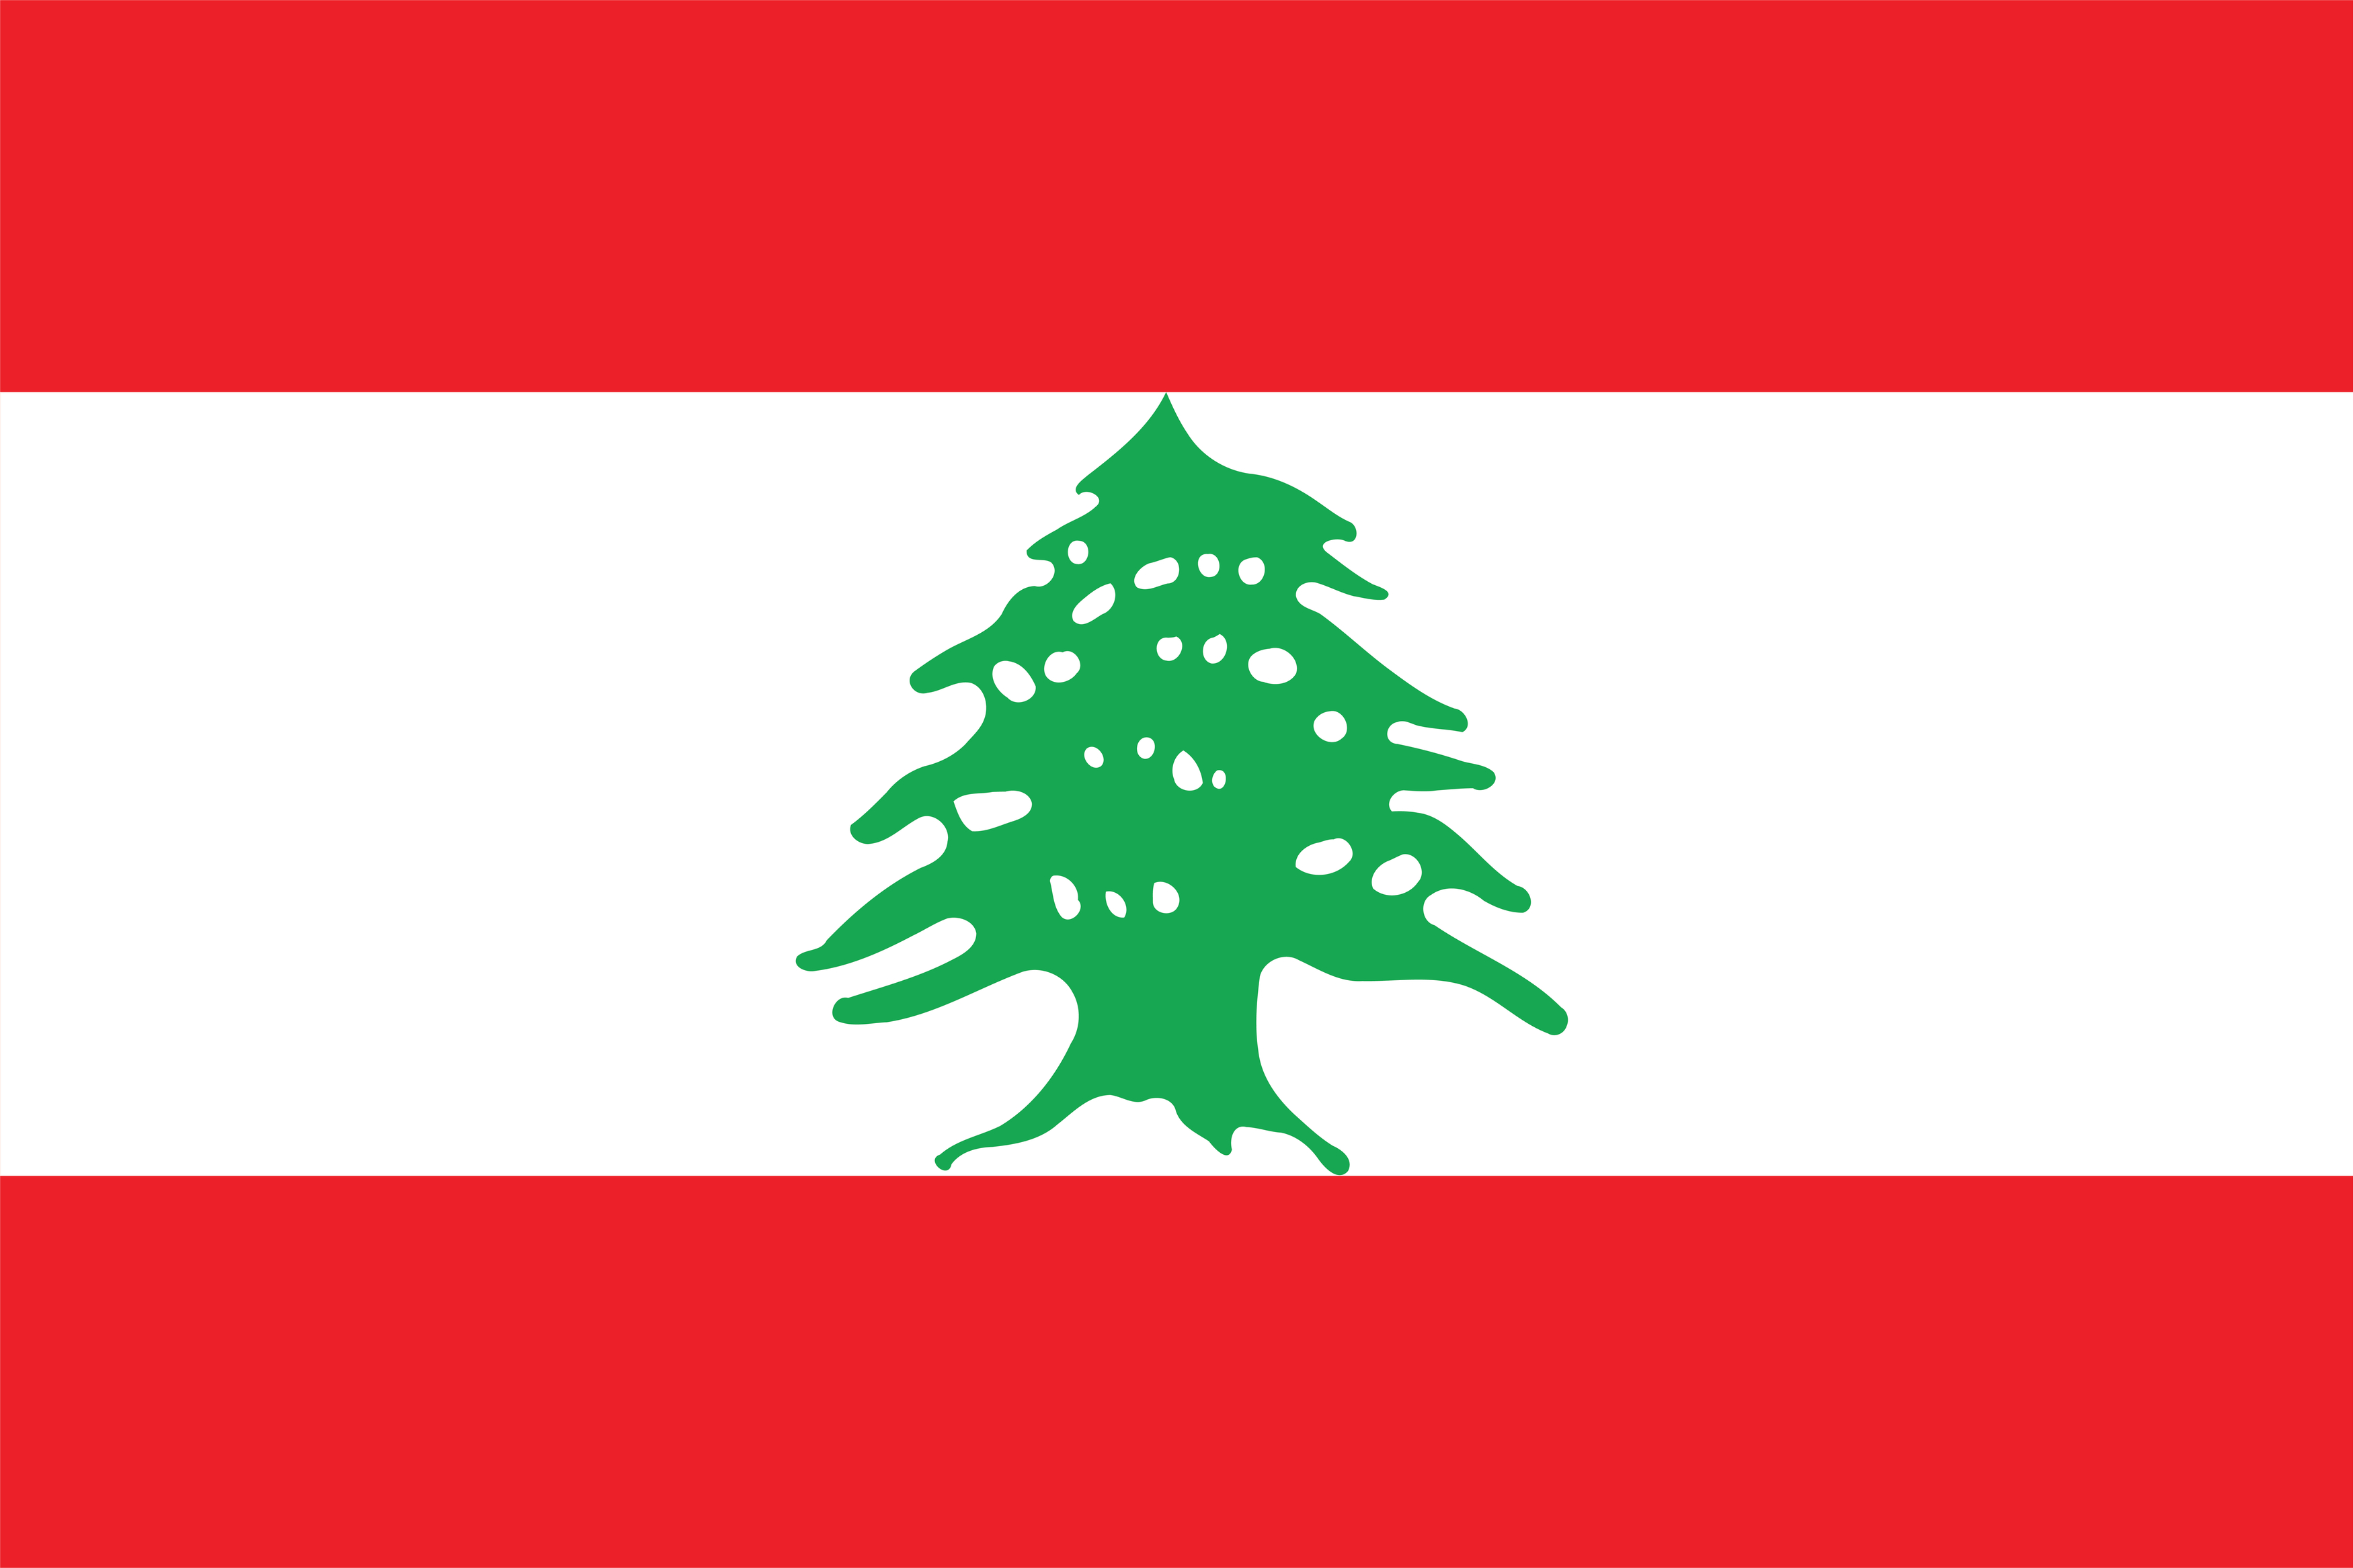
Lebanon flag
Country’s name from the word Labhen: meaning Milk/White/Snow
Red for blood
White for peace/snow
Cedar tree for the Bible
Flag designed in 1943 after Liberation from France

Slide 4
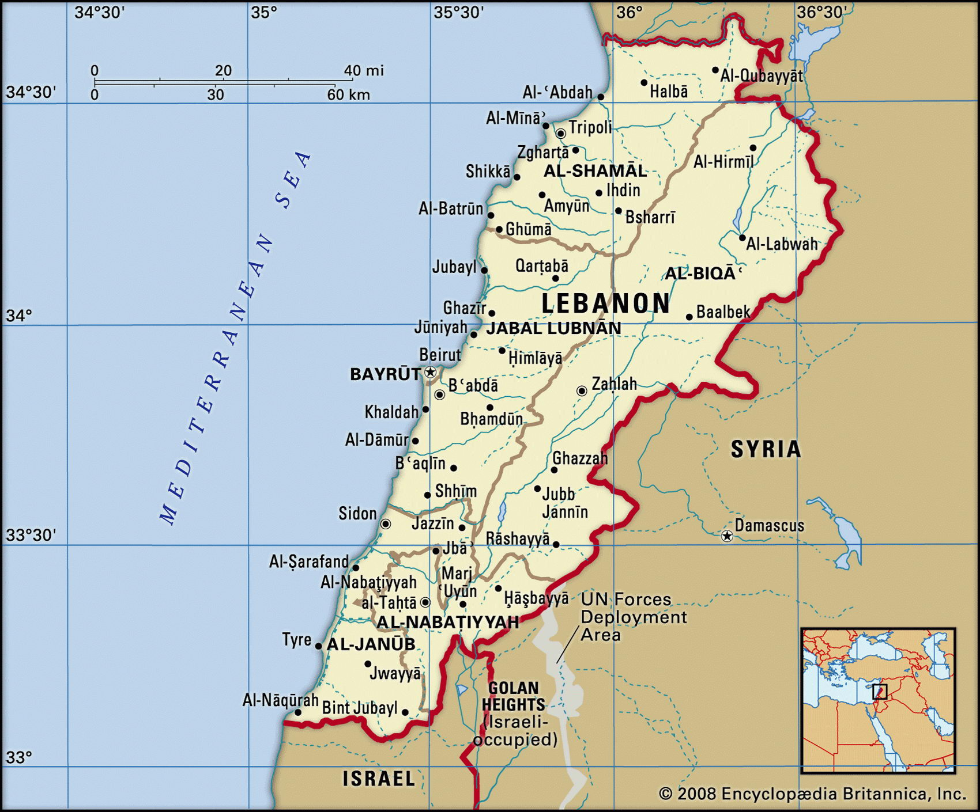
2. GEOGRAPHY

Slide 5
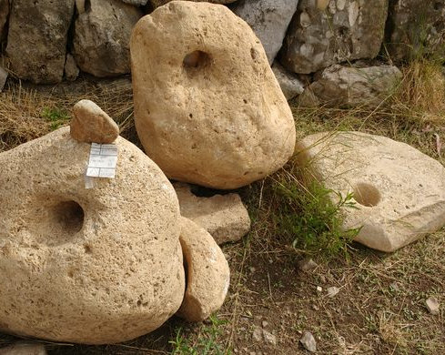
3. HISTORY – VERY ANCIENT
7000 -5000 BC Byblos City (now Jubayl) - One of the oldest continuously occupied cities in the world
Remnants of Primitive weapons, Huts, Pottery

Slide 6
HISTORY - PHOENICIANS From 3300 BC – 539 AD Area called Caanan Earliest true alphabet

Slide 7
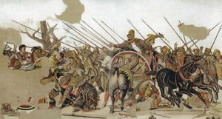
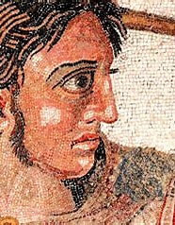
HISTORY – ALEXANDER THE GREAT 356BC - 323BC Invaded and captured ancient city of Byblos

Slide 8
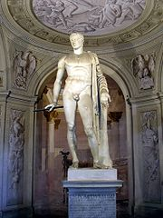
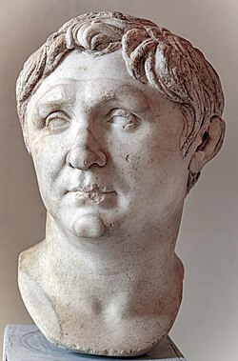
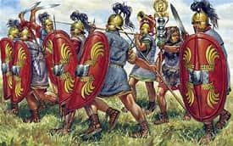
HISTORY - ROMAN CONQUEST – POMPEY, 64BC

Slide 9
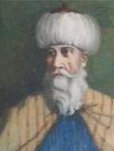
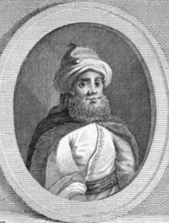
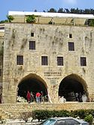
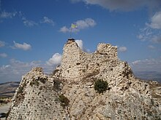
HISTORY - OTTOMAN RULE, 1516-1918

Slide 10
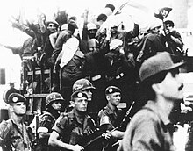
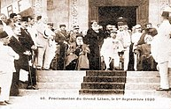
HISTORY – FRENCH INFLUENCE
1831 – French Jesuits from Syria spread Christianity thru Lebanon
1920 – after WWI, French Mandate over Lebanon, until 1943

Slide 11
HISTORY -1932 FRENCH RELIGIOUS CENSUS

Slide 12
HISTORY – INDEPENDENCE FROM FRANCE, 1943

Slide 13
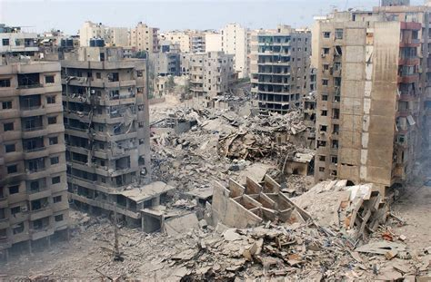
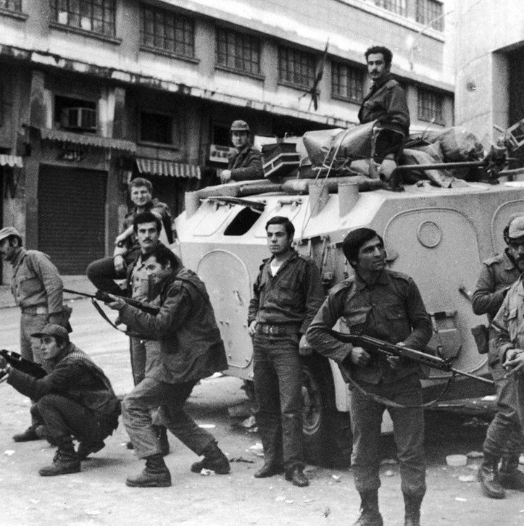
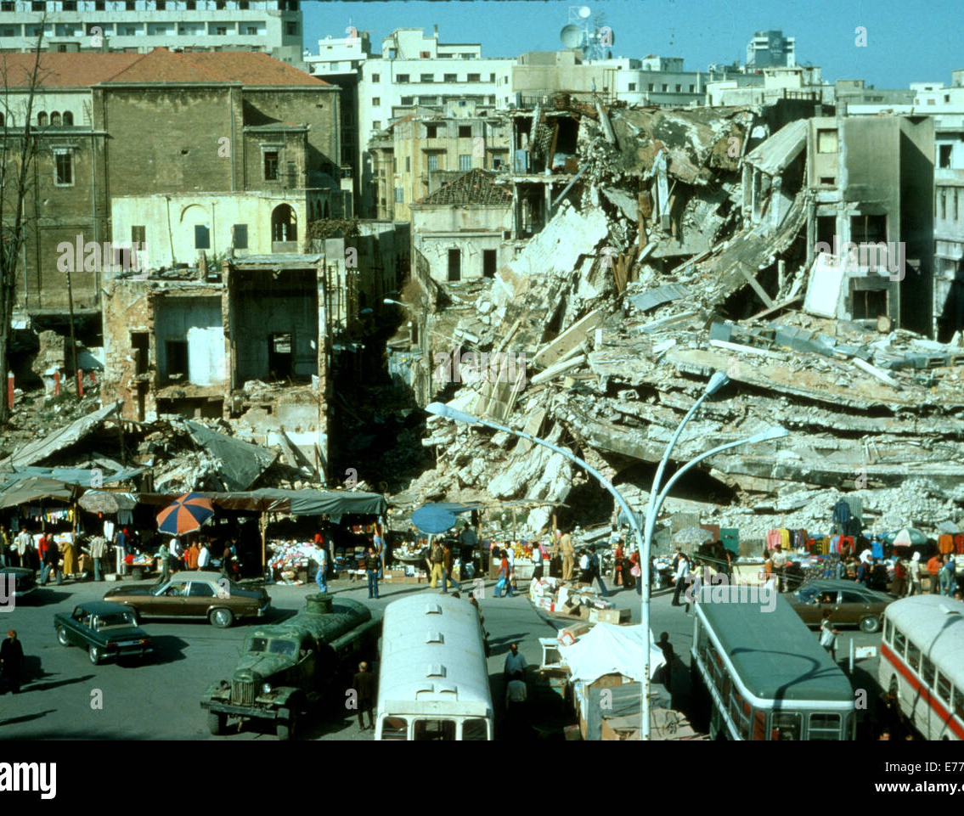
HISTORY – CIVIL WAR, 1975-1990

Slide 14
4. LANGUAGES
Arabic is the official language. Slightly different to other versions
Many people also fluent in French and English
Parley vous Arabe?
Do you speak Arabic?
هل تتحدث العربية؟

Slide 15
5. RELIGION
18 official religious denominations. Latest estimated figures:
69% Muslim
i.e. 32% Sunni, 31% Shi’te,
30.7 % Christian
Of these 52% Maronite, 25% Greek Orthodox, also Protestants, Armenians
5.5% Druze . Follow Old Testament and Mohammed
These figures unreliable, as no census since ….? Polls instead
Officially freedom of religion. BUT Judaism, Mormanism, Buddhism and Hinduism forbidden.

Slide 16
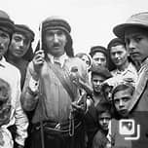
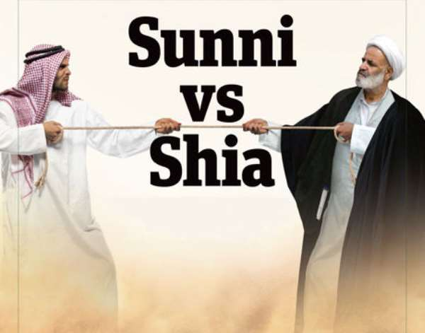
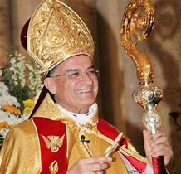
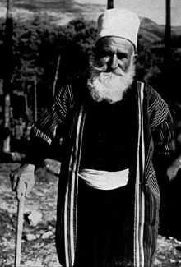
Main Religious Groups
Clockwise: Maronite, Shia, Sunni, Druz, Alawite

Slide 17
6. GOVERNMENT - CONFESSIONALISM
National Pact, 1943 at Independence from France. Tried to create stability for new nation by including all …. religious groups in Govt.
Highest Offices and numbers of MPS reserved for specific religious groups based on % of population.
Population based on census in 1932 which said 51% Christians. Now out of date.
So Christians given most power in Parliament.
Ratio of MPs 6:5 in favour of Christians

Slide 18
GOVERNMENT OFFICES,BY RELIGION
Because there were originally more Christians:
Officers would always be:
President and Armed Forces Chief = Maronite Christian
Prime Minister = Sunni Muslim
Speaker = Shi’ite Muslim
Deputy PM & Deputy Speaker = Greek Orthodox
Armed Forces Chief of Staff = Druze

Slide 19
GOVERNMENT – CONFESSIONALSM 2
Over time, Muslim numbers grew
Why?
Christians no longer majority
Muslims 69%, Christians 30.7
So old distribution unfair

Slide 20
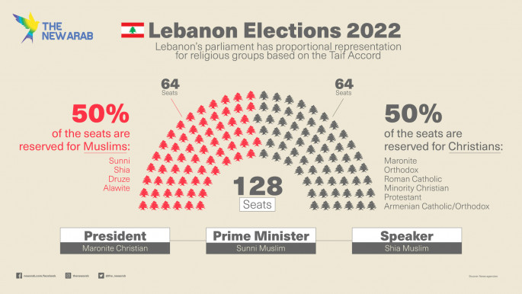
TO BE FAIRER, MPs TO BE EQUAL MUSLIM AND CHRISTIAN, SINCE 1989

Slide 21
DEMOCRACY?
All citizens can Vote
Constitution says people can topple Government at election

Slide 22
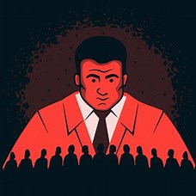
OR, AUTHORITARIAN ?
Elections Free and Fair?
- No elections, 2009-20, partly due to Civil War
Up to half the population are not citizens, so can’t vote
Voting manipulated by elites through vote buying, sponsorship
Intimidation of voters and Independent Candidates
- President has almost total power. Chooses P.M. Can dismiss govt.
- 2015 Lebanon ranked 98th out of 167 countries in Democracy Index
- 2023 the system was internationally designated “Authoritarian”

Slide 23
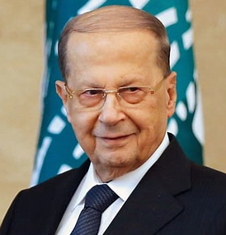
PRESIDENTIAL OFFICE
Michael Aoun, President 2016-2022
Maronite Christian
Ally of Hezbollah - “Iranian President”
As at 2024 no replacement
Stalemate re choosing another Pres.
Much foreign interference

Slide 24
7. HEZBOLLAH IN LEBANON – MILITARY
Created in 1982 by Shia Clerics in iran. To defeat IDF in Lebanon. Won 2022
Has 100,000 fighters and huge arsenal
Many battles with IDF over the years
2006. Full blown war. 1000 Lebanese killed. Mostly Civilians.
After October 7th 2003, tensions built with Israel
June 2024 Hezbollah launched rockets into Israel. Caused major fires
Considered “Terrorists” by the West

Slide 25
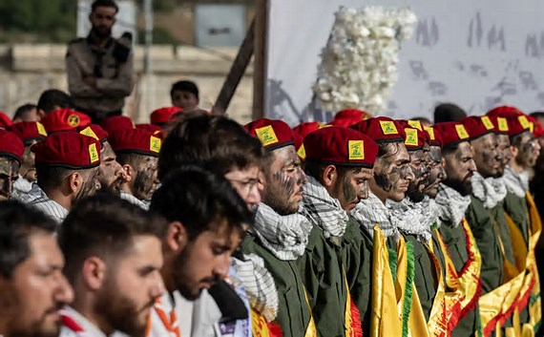
HEZBOLLAH – MILITARY 2

Slide 26
HEZBOLLAH IN LEBANON - POLITICS
“Most powerful single political movement in Lebanon”
2018 elections they + allies won veto power of Cabinet
Also won power over Parliament. 70%

Slide 27
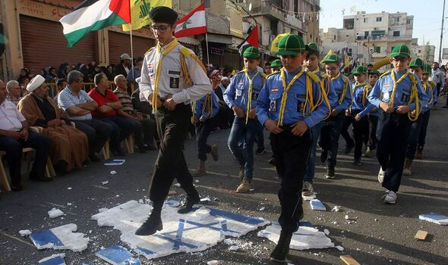
HEZBOLLAH IN LEBANON - SOCIETY
Runs its own Bank/Charity – gives loans to the poor.
Runs Network of schools which teach Antisemitism and Terrorism. Also Clinics and Social Services
This makes them popular with citizens. Increases their vote
Money for this comes from global financial/criminal network
Eg Drug and Firearm trafficking, money laundering

Slide 28
AN ATM AT AN HEZBOLLAH OWNED BANK

Slide 29
8. REFUGEES
Highest no. of refugees per capita in the world
1/4 to 1/2 of total pop!!
Up to 3 million
More than half are school age
No accurate figures.
Births & deaths not registered
No census since …..

Slide 30
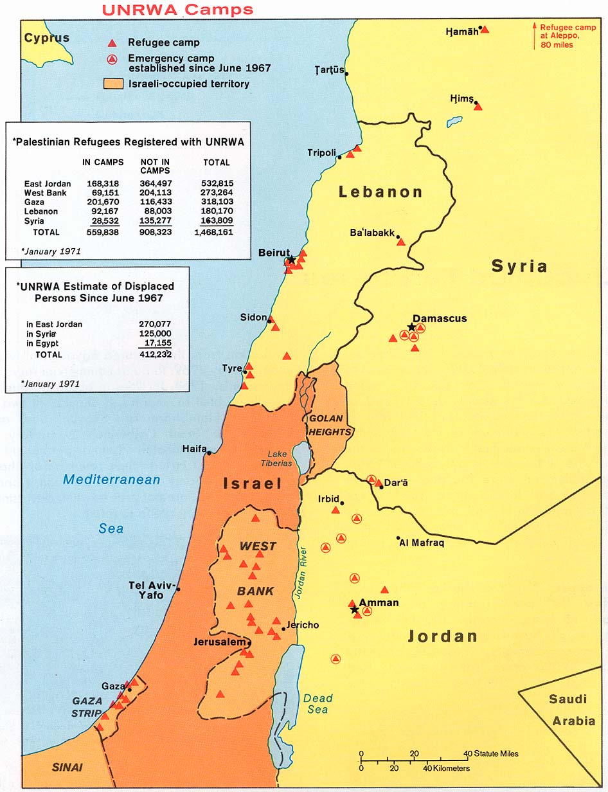
WHERE DID THEY COME FROM?
ri1. From Syria
Total: 1.5 million. plus
Consist of: Syrians,Turks, Kurds, and
Palestinians,
2017 polls said 250,000 Palestinian refugees.
Many not counted.
Many are descendants of refugees from the 50s.
So long in the camps!
80% living below the poverty line
2. From Iraq – up to 650,000. Mostly Muslim

Slide 31
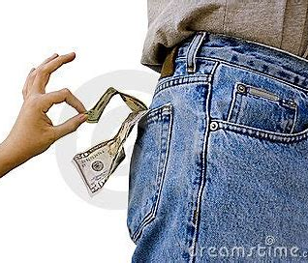
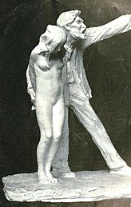
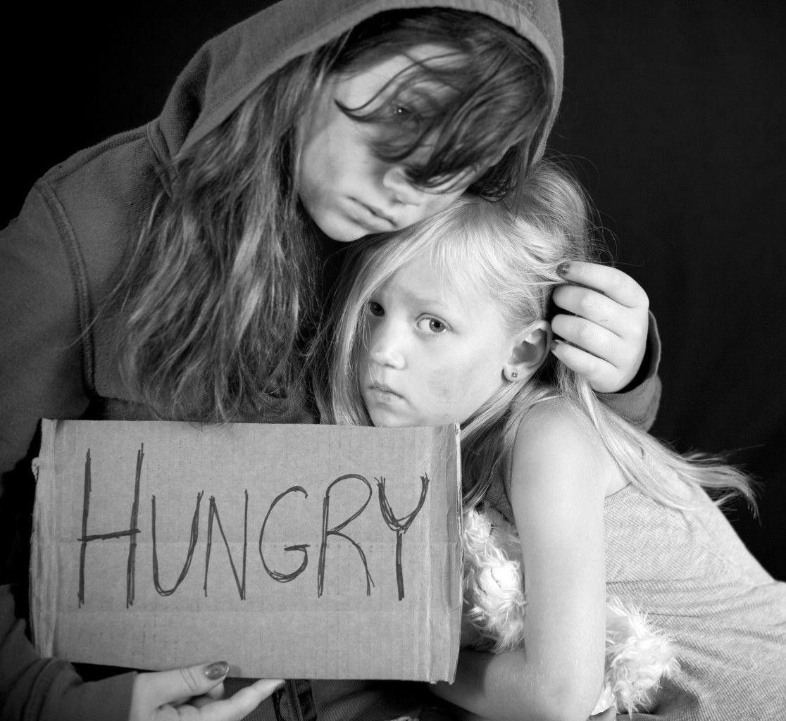
REFUGEE CAMPS
TERRIBLE CONDITIONS
Live in tents or home-made shacks
Little water, little food, no power,
no sanitation
Violence against women and children. Women sometimes sex slaves
Children often sent to work at young age. Made to steal or are trafficked. No school

Slide 32
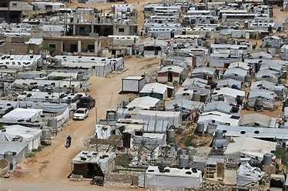
REFUGEE CAMPS IN LEBANON

Slide 33
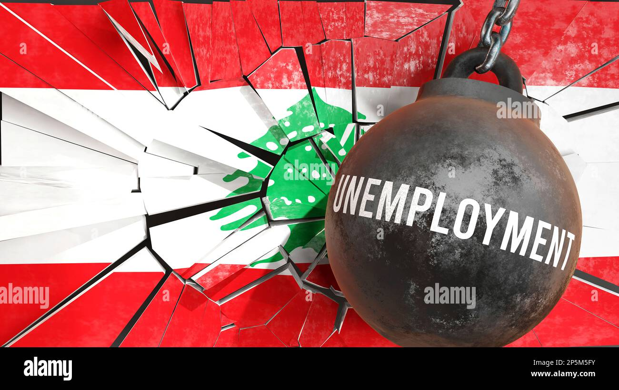
IMPACT OF REGUGEE INFLUX
EXPLICIT IMPACT
Unemployment doubled to 20%.
Population density greatly increased.
About the same population as NZ,
(5.2m and 5.3m) but 270 times smaller.
COMBINED IMPACT
Another nail in the coffin of a dying country

Slide 34
9. LEBANESE DIASPORA
More Lebanese live outside than inside Lebanon i.e approx. 14m expats
Why leave? Occupation by Ottomans, Attacks by Israel and Syria, Civil Wars, Political and Economic Crises
Which country has most Lebanese? Estimates of 10m. BRAZIL
Why there? Brazilian President sought “white, Christian immigrants”

Slide 35
LEBANESE DIASPORA 2
Lebanese immigrants “rich, educated and influential”
Send money home. 18% of Lebanese economy in 2014

Slide 36
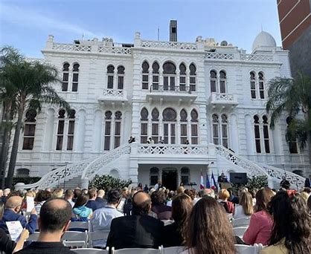
10. RELATIONS WITH AUSTRALIA
‘Friendly relations’. Australia had
Embassy in Beirut since 1967
- Since 1956 ADF provided military observers
Since 2017 Australia has given $120
million to support Refugees
After the explosion of 2020 it gave $5m for
humanitarian help
NOT A LOT OF INTERACTION

Slide 37
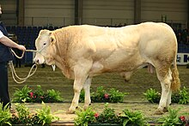
RELATIONS WITH AUSTRALIA - TRADE
2020 -21 Total two way trade worth $94 Very small
Cf Trade with NZ (same pop) = $27,800m.
Main exports from Australia = veg, beef, medical supplies
Imports to Australia = very little
Lebanon has very few resources now (most cedars chopped down). Only 11% is arable land. Few minerals
Plus, the economy has collapsed
What’s to trade?

Slide 38
RELATIONS WITH AUSTRALIA - IMMIGRANTS
In 2021, 248,000 Australians have Lebanese ancestry, 76% in NSW
Often business, political or sports people, eg Steve Bracks
First came to Aus. in late 19th century – Ottoman persecution.
Then a wave with each crisis, eg 6 Day War, 1967; Civil War, 1975-90
BUT
- 1901 White Australia Policy restricted Lebanese immigration.
Until 1960 only allowed in if had family links. Cf Brazil….

Slide 39
CRONULLA RIOTS, 2005
Racial violence between Caucasian
Life Guards and Lebanese
after build up of tensions.
Conflict spread. Riots and Crime
‘

Slide 40
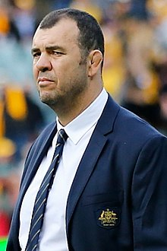
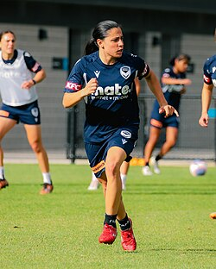
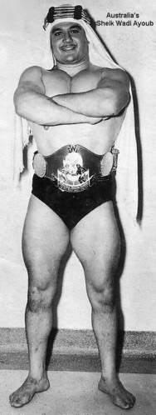
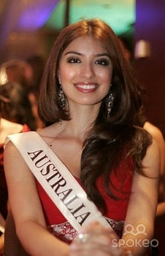
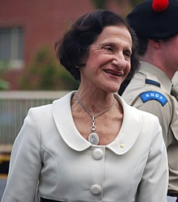
FAMOUS LEBANESE AUSTRALIANS

Slide 41
CRISES
Government
Electricity
Environment
Banking/Finance
Social/Health

Slide 42
GOVERNMENT
Government and senior public positions held by previous sectarian warlords and party barons.
Sectarian government rife with corruption and nepotism – entrenched vested interests.
Government very centralised - power concentrated on a select few.
Government chooses judges on Supreme Judicial Council.
Consensus-based system – often prolonged crises.
Strong relationships (!!) between government, business people and banking industry.
Bribes needed to get government contracts and deal with public officials.

Slide 43
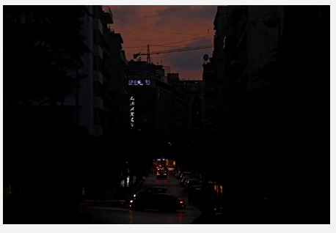
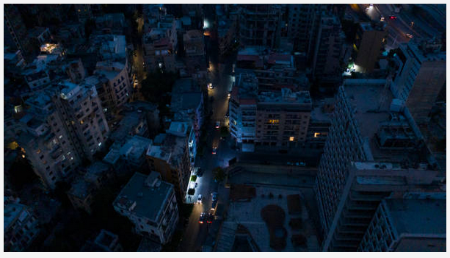
ELECTRICITY
Electricite du Liban provides state-wide electricity.
Frequent power outages.
Diesel generators needed.
Used for political means.
Runs at a loss → financed by central bank → public debt.

Slide 44
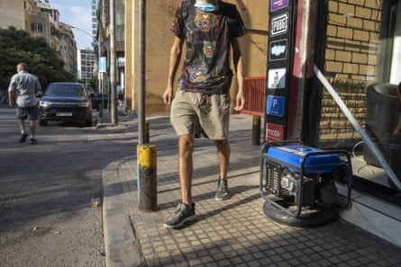
ELECTRICITY and DIESEL GENERATORS
Citizens have to pay EDL and polluting private diesel generators.
Many can hardly afford this.
Constant use of diesel generators – impact on environmental + public health.
Relationships between private fuel importers and generator owners.
Wealthy can afford all forms of electricity.

Slide 45
GARBAGE CRISIS
Garbage managed by private contractor - nepotism!
Huge landfill site closed
July 17, 2015.
Government authorities
failed to implement
contingency plan in time.
Stench! High mountains
of rubbish everywhere.
Dumping and burning
waste in streets.
Public outrage!

Slide 46
“You Stink” MOVEMENT
Public outraged by years of government’s ineptitude and nepotism, leading to garbage crisis.
Led to “You Stink” movement.
Massive public demonstrations.

Slide 47
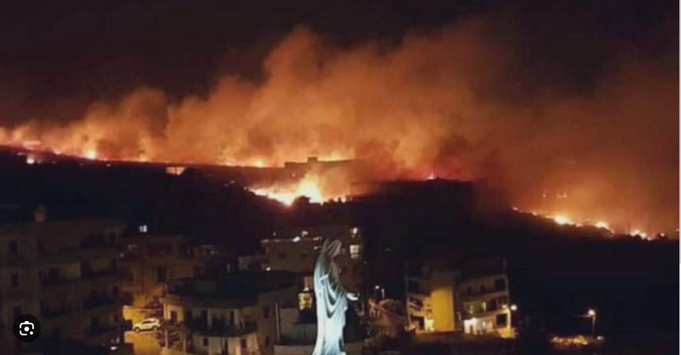
LEBANON WILDFIRES 2019
Started 14 Oct 2019, lasted 2 days.
Worst wildfire event in decades.
Burnt 3155 hectares of western mountains.
Extensive property damage
Lebanon’s own firefighting aircraft non-operational – had fallen into disrepair.
Cyprus, Greece and Jordan called on to help.
Public anger!

Slide 48
BEIRUT EXPLOSION 2020
Country in state of crisis before explosion (economy, poverty, COVID-19)
On Aug 4th 2020, 2750 tonnes of ammonium nitrate, stored unsafely in
warehouse in Port of Beirut, exploded.
One of most powerful non-nuclear
explosions on record (1.1 kilotons TNT).
- 218 deaths.
- 7000 injuries (150 perm. disabled).
- Many foreign visitors died or injured.
- 300,000 people homeless.
- US $15 billion property damage.
- Hospitals, hotels, museums, churches
destroyed or damaged.
- Grain silos ultimately collapsed in 2022 – food shortage exacerbated.
Prime Minister Hassan Diab and Lebanese cabinet resigned.
All kinds of aid flowed in, within Lebanon, and world-wide.

Slide 49
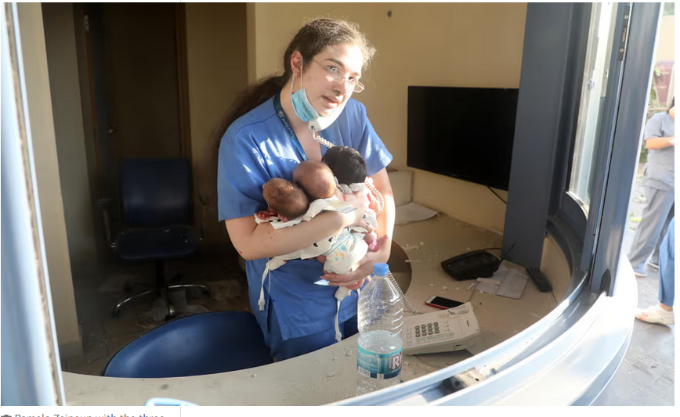
BEIRUT EXPLOSION 2020
Protests erupted around Lebanon against Gov’t for failure to prevent disaster.
Dealt with brutally by security forces.
Investigations into cause of explosion commenced soon after.
But still no resolution in 2024 – prolonged legal battles.

Slide 50
FINANCIAL CRISES – UP TO 2019
After Civil War, Lebanon’s banks balanced books with tourism, foreign aid, remittances, banking secrecy, high interest rates.
From 2016 onwards ....
- Marked slowdown in foreign inflows
- Budget deficit skyrocketed
- Balance of payments sank deeper
- Shortage of US dollars in commercial banks
Lebanese pound lost value on black market.
To cope with impending liquidity crisis, Banque
du Liban bought Eurobonds and undertook other forms of “financial
engineering”.
These measures increased foreign capital inflows, but markedly increased liabilities.
So – banks further into debt.

Slide 51
OCTOBER 2019 PROTEST – A CATALYST
People were becoming increasingly angry with
- Gov’ts failure to provide basic services.
- Gov’ts failure to deal with ailing economy.
- money withdrawal problems.
- price rises, inflation.
- high unemployment.
- corruption!
- inadequate response to wildfires
on Oct 14 2019.
Then, Gov’t proposed extra taxes
on tobacco, petrol and voice calls via messaging services such as
WhatsApp to drum up more revenue. THIS WAS THE LAST STRAW!
Within days, tens of thousands took to the streets to protest.

Slide 52
WHAT HAPPENED AFTER THE 2019 CIVIL PROTESTS?
WhatsApp tax removed.
Prime Minister Saad Harari forced to resign.
Protesters wanted complete overhaul of political system.
Only small changes; much resistance from elite.
Huge economic repercussions
- acute US dollar shortages.
- people prevented from
withdrawing their own deposits.
- some armed demands from
depositors; later, burning of banks.

Slide 53
HUGE ECONOMIC REPERCUSSIONS AFTER 2019
Abrupt reduction of O/S capital inflows.
Gov’t defaulted on Eurobonds – first sovereign default in its history.
Negotiations with IMF rescue package stalled by Gov’t.
Currency continued to collapse (by 2023, LL had lost 98% value).
Inflation soared (45 fold increase in 2023)
Businesses shut down; increasing unemployment.
Huge losses in purchasing power of essential goods.
Public generators ran out of fuel.
Shortages in import of vital medicines.
Exacerbated by COVID-19, global energy crisis and Beirut explosion.

Slide 54
PUBLIC HEALTH/SOCIAL CRISES
Many citizens can hardly afford the basics - food, electricity, petrol, medicine.
Public services greatly reduced.
Acute shortage of medicines.
80% of senior population has no safety net.
Many nursing homes for the elderly are barely functioning.

Slide 55
WHAT ABOUT THE WEALTHY ELITE?
Lebanese economy almost cash-based.
Elite operate within shadow economy.
Ready access to overseas US $$.
Private sector doesn’t rely on Gov’t services or pay much tax.
Any US $$ earned during tourist season stay with tourist operators – not back into Lebanese economy.
Exporting businesses have bank accounts outside country.
No problems with electricity supplies.
No desire to negotiate international aid, with mandated reforms.

Slide 56
WHERE, NOW?
Comment:
France and Germany have issued an international arrest warrant for Lebanon’s central bank chief Riad Salameh – for amassing sizeable assets across Europe with the help of a complex fraudulent financial system and extensive misuse of Lebanese public funds during his 3 decades as central bank boss.
Any other suggestions?

